Slide 1
The Apprentice Learning Experience

Slide 2
Partnership in learning
This document is designed to introduce you to the Apprentice Learning Experience.
It covers the Apprentice Learning Experience and explores how you can use it to assist you to feed back about your experience of the taught part of your apprenticeship when in college.
We hope that it will allow you to develop some of the skills you will use to be able to provide valuable feedback.
We would also like to use it to alert you to the opportunity of becoming an apprentice rep. We will explain what the apprentice role is and describe the work involved in being an apprentice rep, and the benefits.
Notes:
2

Slide 3
sparqs
student partnerships in quality scotland.
Our role is to ensure that students can make a positive difference to learning and teaching.
4330 reps trained in the academic year 2014-15.
Funded by the Scottish Funding Council since 2003.
Supporting students on different learner journeys.

Slide 4
Feeding back about your experience of learning is important
Apprentice
views
Dialogue
with teaching staff/training providers
Improved learning
experience
because you are an expert on your learning experience.
You are an expert because you are living it!

Slide 5
Your apprenticeship
Questions…
What do you most like about your apprenticeship?
What would you like to change or improve about your apprenticeship?
Notes:
5

Slide 6
Learning and Teaching
When apprentices are in the taught part of their apprenticeship it is really vital that the college and the apprentices have a channel of communication with each other to ensure that the best learning experience is on offer.
One of the main ways in which we can do that is by apprentices feeding back to the college information on their experience of learning.
In order to do that it is important that everyone focuses on the appropriate elements and with the same language.
To do that we have created a tool called the Apprentice Learning Experience. The ALE is designed to enable you to easily identify what areas you can and cannot affect when you are in the taught part of your apprenticeship in college.

Slide 7
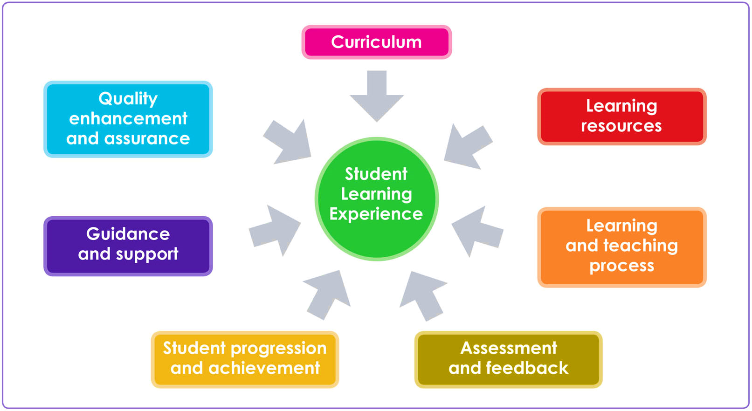
The Apprentice Learning Experience
Apprentice Learning Experience
Progression and achievement
Notes:
Introduce this by asking the whole group to come up with ideas about they understand by all of the headings on the SLE – Curriculum, Learning Resources, Learning and Teaching Process etc.

Slide 8
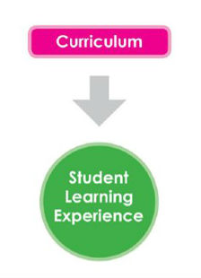
Curriculum
This describes the content of the taught section of the apprenticeship and how that is structured.
Are the learning objectives clearly stated and being followed?
Does the curriculum being taught match your expectations from the information provided about the apprenticeship?
Can you see how the taught part of your course relates to the reality of the work place?
Apprentice Learning Experience

Slide 9
Learning Resources
Staff, equipment, tools, text books, manuals and appropriate clothing.
Workshops, classrooms, labs, lecture theatres, IT, VLE resources.
Does the equipment in college adequately prepare you for work based application?
Apprentice Learning Experience

Slide 10
Learning and Teaching Process
How apprentices are taught and how they learn.
The range of teaching methods that are used.
Is it the right method for the type of apprenticeship?
Is it accessible?
Do your teachers and tutors draw on real life experience?
Apprentice Learning Experience
Notes:
The range of teaching methods that are used? Lectures, tutorials, practical work, labs, group work.
Is it the right method for the kind of course? Is there a good balance of theory work and practical activity?
Is it accessible?

Slide 11
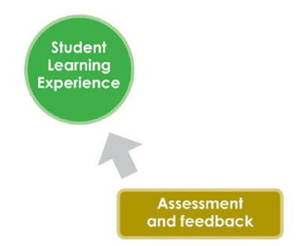
Assessment and Feedback
Are assessments spaced out well?
Are they the right kind of assessments for the type of module/unit/course?
What kind of feedback is given? Is it of good enough quality?
Does feedback help you see where and how you need to improve?
Are the assessments work based or college based and how do they relate?
Apprentice Learning Experience

Slide 12
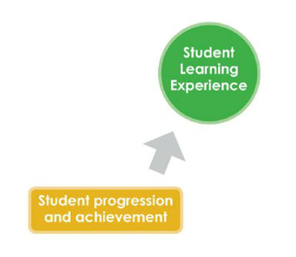
Progression and Achievement
Are you able to progress easily from one module/unit to the next?
Are you able to evaluate your own personal progress throughout the apprenticeship?
Are further progression opportunities and pathways made clear to you?
If your apprenticeship has an opportunity of employment at the end of it is that route clear and transparent for all?
Apprentice Learning Experience
Progression and achievement

Slide 13
Guidance and Support
How much support are you receiving with the academic aspect of your apprenticeship?
If you are struggling, where do you go for advice?
Are you given clear guidance on what is expected of you as an apprentice?
Do you have identified guidance for the taught part of your apprenticeship?
Is it made clear to you within college and employer settings where to get support on a range of issues?
Is it made clear to you which policies apply to you as a student and you as an employee?
Are you aware of the avenues of support that relate to your student experience and your employee experience, e.g. student support, HR policy and Trade Unions?
Apprentice Learning Experience

Slide 14
Quality Enhancement and Assurance
Do you feel that staff and the training providers are receptive to apprentice concerns and suggestions?
Do you feel that you and your fellow apprentices’ opinions are listened to?
What improvements have been made to your apprenticeship during your time of learning?
Are you confident issues raised with the college are passed to employer and vice versa?
Apprentice Learning Experience

Slide 15
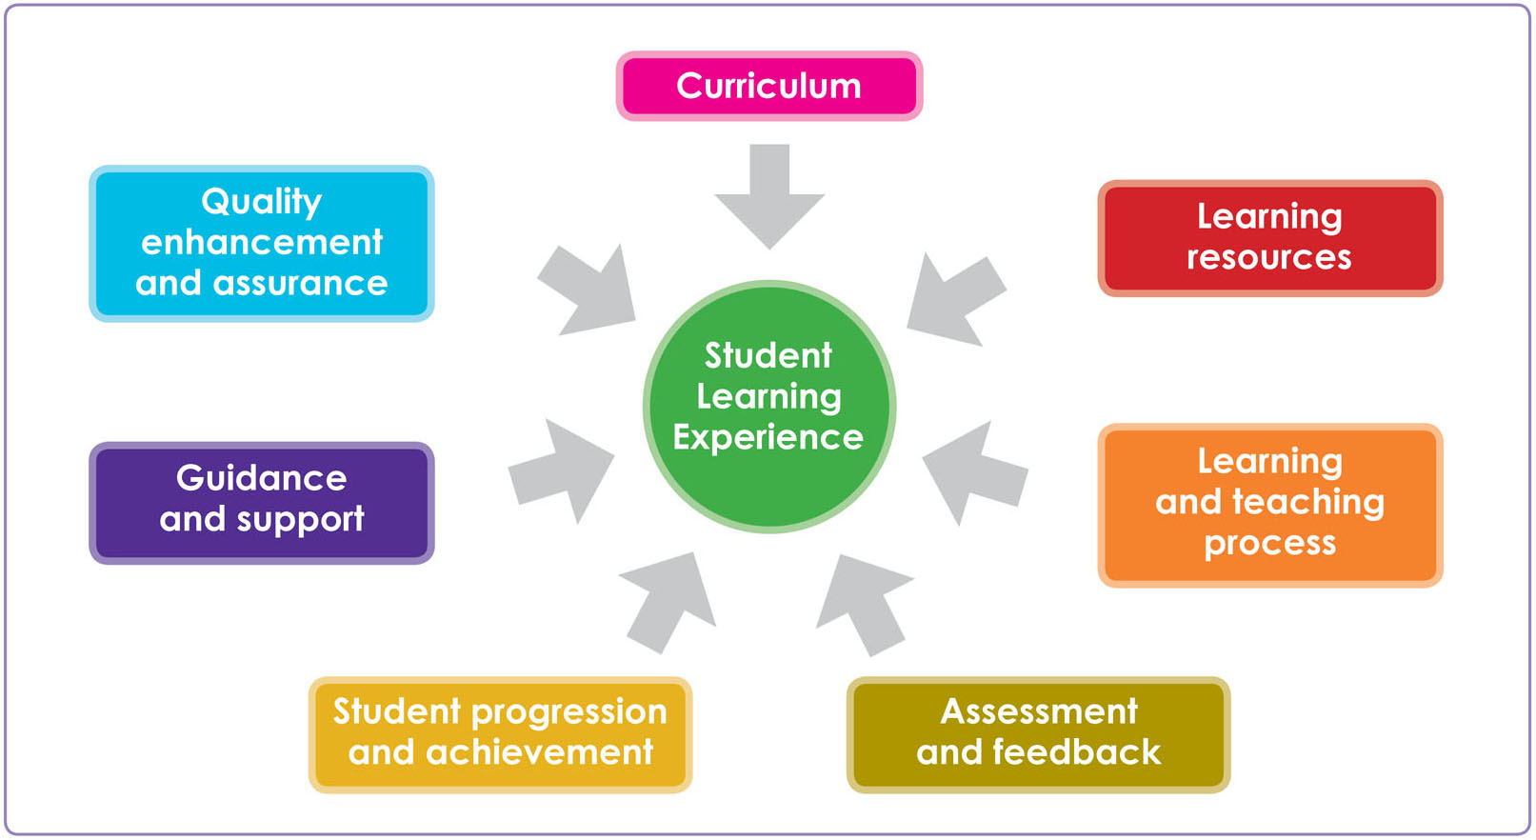
Exercise 4 – using the ALE
Think about the element of your taught apprenticeship that you previously identified as something you would like to improve and consider where it can be placed on the Apprentice Learning Experience Diagram.
Doing this allows you to break things down into identifiable and specific areas.
It also introduces you to the language that colleges use when they talk about learning and teaching.
If your issue does not fit onto the ALE then it does not mean it is not an issue but it means it will be related to the wider apprentice experience rather than the taught part which is what we are dealing with.
Apprentice Learning Experience
Progression and achievement
Notes:
This exercise should enable you to have a short discussion on the SLE. Have they placed the improvement suggestions on the right part of the SLE? Does their example fit the SLE at all or should it be dealt with by someone else?

Slide 16
The Cycle
Identify issues
Feedback
to the college
Work in partnership to develop &
implement
the solution (or at least try to)
Notes:
Recap slide – we showed it before the break – the slides have expanded language

Slide 17
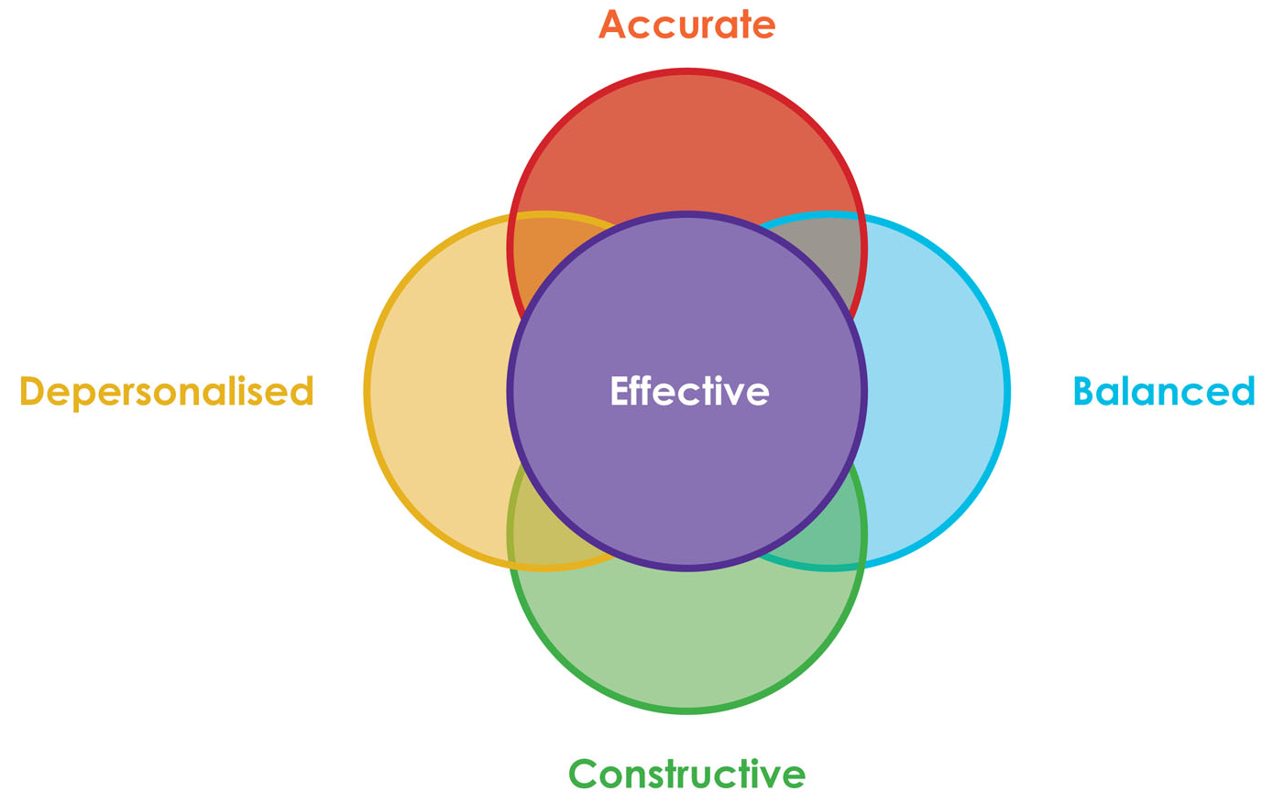
It’s important to give the right kind of feedback! The A,B,C,D of Effective Feedback

Slide 18
A is for Accuracy
When we comment on the learning experience we should be specific, and provide evidence for what we’re saying.
Avoid sweeping generalisations or emotional language.
Where possible include information about the scale of the issue – percentage of apprentices affected if it is more than just you, to add weight to your argument. Doing so shows you have accurately researched the issue.

Slide 19
B is for Balanced
We shouldn’t only pass on negative comments to staff, even if that’s mostly what we’re hearing from other apprentices or feeling ourselves. We might see that staff have been trying hard but it hasn’t helped, or isn’t helping in the right ways – make sure not to be one-sided or biased in any particular direction.
Having a balanced perspective will be hugely beneficial to your work and it’s critical for working with everyone connected to learning.

Slide 20
C is for Constructive
We are not all here just to identify the problems, we’re also here to help find a solution too.
So if you raise an issue, you should make a suggestion at the same time or ask for help in putting one together.
In colleges there are course reps and students’ associations that can help you do this. It is their job to help facilitate solutions. You can be one of these reps if it is something you would be interested in.
It is not of any benefit just to criticise. Being negative, or unbalanced, or inaccurate only makes it easier for people to ignore what you are saying, even if it’s valid.

Slide 21
D is for Depersonalised
Even if an apprentice thinks that a member of staff has done something wrong, they shouldn’t make personal comments.
Don’t comment on a specific member of staff directly, talk instead about the impact on your learning experience.
Remember as well that people are always working within larger systems and you may not always have the full picture – sometimes a person’s professional failing is seen elsewhere and is a systemic problem.
In the workplace diplomacy is a key skill that is required so remember not to be disrespectful of anyone in any way.
Notes:
This leads us to say that the best way to give feedback is using an ABCDE model.

Slide 22
Developing solutions
Think back to the issue you wanted to improve about your learning experience.
How would you tackle this to try and come up with a solution which would benefit you and other apprentices?
You need to think about:
How do you find out what other apprentices think?
Where will you take your issue and suggestions?
How will you word it? Remember ABCD.
How would you go about getting the solution implemented?
What is the time scale for the implementation?
Notes:
22

Slide 23
Making change happen
Do you get the opportunity to feed back? Is your voice heard at various levels throughout the college management boards? Do you take that opportunity to attend these sessions? Do you engage with it? Do you feel you are a partner in your learner journey?
Opportunity Attendance Engagement

Slide 24
Apprentice Reps
One of the ways in which colleges ensure that students are partners in their learning is by having course reps.
Each class or course in college has an identified student who acts as a spokesperson for the class.
This way it allows for much easier communication.
It is the class rep’s job to gather student opinion and feed that back to the college.
The class rep system allows for the college to work with the students on issues affecting their experience of learning and teaching.
Learners take on many different journeys so it is important that everyone gets a chance to have their voice heard.
Becoming an apprentice rep allows you not only to have your voice heard, but also to be the representative for a group of apprentices.

Slide 25
Purpose of a rep
To continuously improve the apprentice learning experience in partnership with the employer, the institution/training provider and, where appropriate, the students’ association by helping create solutions to problems.
To represent your fellow apprentices’ views and opinions on all matters relating to the learning and teaching aspect of their apprenticeship.
To provide both positive and negative feedback.
To act as a communication channel between apprentices and their learning provider.
Notes:
This slide is just reinforcement for what they have already covered on the flip chart in more general terms

Slide 26
Benefits of being a rep
Learn new skills.
Looks good on your CV.
Networking opportunities.
Background for future representational roles.
Good experience for future employment.
Can be validated on student transcripts for further/higher education.
Make a difference.
Notes:
And this final one

Slide 27
Rep tasks
Introduce yourself to your group.
Gather apprentice opinion.
Provide feedback to learning providers.
Present apprentice views at meetings.
Attend meetings.
Speak to people outside of meetings.
Develop solutions to issues.
Pass issues onto students’ association where appropriate.
Contribute to institutional activities.
Pass on information to the employer where appropriate.
Notes:
27
As is this slide

Slide 28
Rep skills
Organisation.
Report writing.
Diplomacy.
Negotiation.
Research.
Time management / prioritisation.
Communication.
Listening.
Networking.
Relationship building.
Reflection.
Presentation.
Notes:
And this slide

Slide 29
One of the main ways colleges ask learners to feed back about their learning experience is by attending meetings
Think about what you would do:
Before you to go to the meeting?
During the meeting?
After the meeting?
Notes:
29
This is a whole group flip chart exercise. Put up 3 flipcharts or the equivalent with before, during and after and write up suggestions from the group. This could also be done on a laptop, projecting onto the screen if you wish.

Slide 30
Before a meeting
Where and when is the meeting going to take place?
Find out what your fellow apprentices think about their learning experience if appropriate.
Is there anything you want to put on the agenda? (This is just an official list of items to be discussed.)
Read any of the papers that have been sent round, including the previous meeting’s minutes.
Speak to other apprentices and apprentice reps in the college.
Speak to the students’ association, they can provide you with support in preparing for the meeting.
Notes:
The following 3 slides are just reinforcement hopefully they will have shouted out most of these!

Slide 31
During a meeting
Always be on time, if you are going to be late let the staff member/tutor/Chair/Secretary know before the meeting.
Be prepared to take notes if necessary.
Remember the A, B, C and D of effective feedback.
Ask questions if you do not understand anything.
Support other apprentices and apprentice reps in the meeting.

Slide 32
After a meeting
Report back to your fellow apprentices if appropriate.
Check the minutes (this is the notes taken throughout the meetings, detailing what was discussed).
Do anything you have been asked to do.
Follow up any areas of concern.
Did you achieve what you wanted to achieve? If not what are you going to do about it?

Slide 33
Support available to you
National Society of Apprentices Scotland via http://nsoascotland.co.uk/
Online training resources are available via www.sparqs.ac.uk
NUS Scotland, the national student representative body, can support you. Visit www.nus.org.uk for more information.
Students’ Associations.
Trade Unions/Employer engagement schemes.

Slide 34
Interested in becoming an Apprentice Rep?
Contact the Students’ Association within the college.
Online training resources are available via www.sparqs.ac.uk
For further info about any of these opportunities, contact Morven Stewart – morven.stewart@sparqs.ac.uk
Notes:
34

